Slide 1
Enhancing Image Captioning with Advanced Deep Learning Techniques
Hamza and Anna

Slide 2
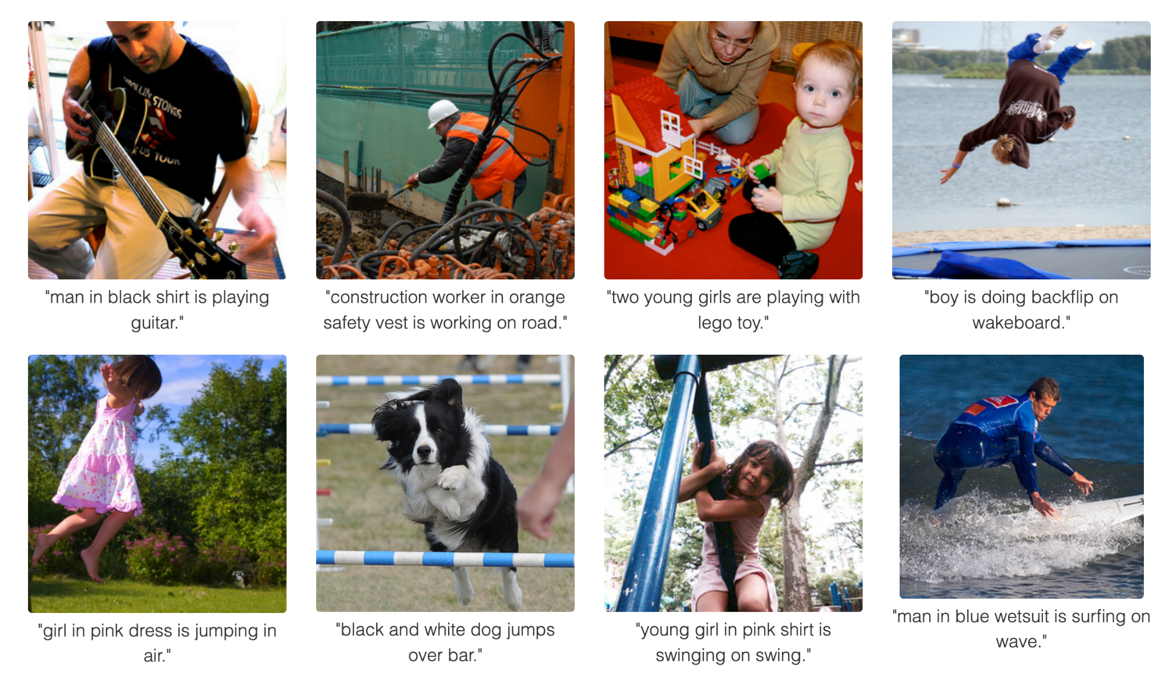
Introduction
What is Image Captioning?
Image captioning is the process of generating textual descriptions from images.
Importance
Essential for making visual content accessible, assisting the visually impaired, and enhancing image retrieval.
Goals:
Explore the intersection of computer vision and NLP to tackle the problem of image captioning.
Implement and evaluate a model that leverages both Convolutional Neural Networks (CNNs) for image feature extraction and Long Short-Term Memory (LSTM) networks to generate captions.
Introduce an attention mechanism to improve the relevance and accuracy of the generated captions by focusing on specific regions of the image during the captioning process.
Ref: https://cs.stanford.edu/people/karpathy/deepimagesent/

Slide 3
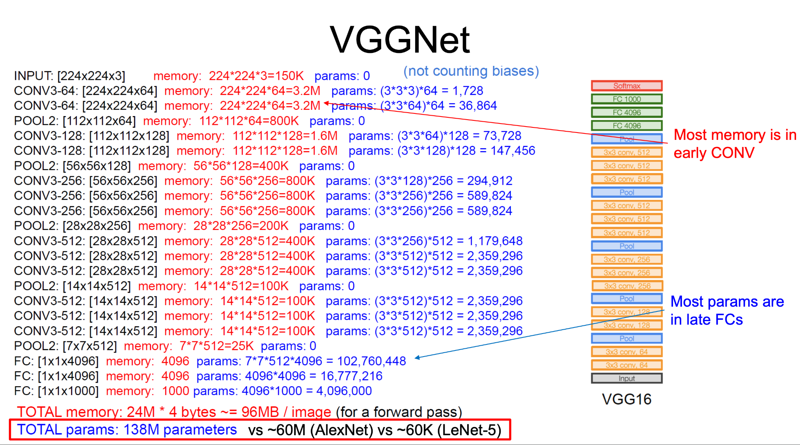
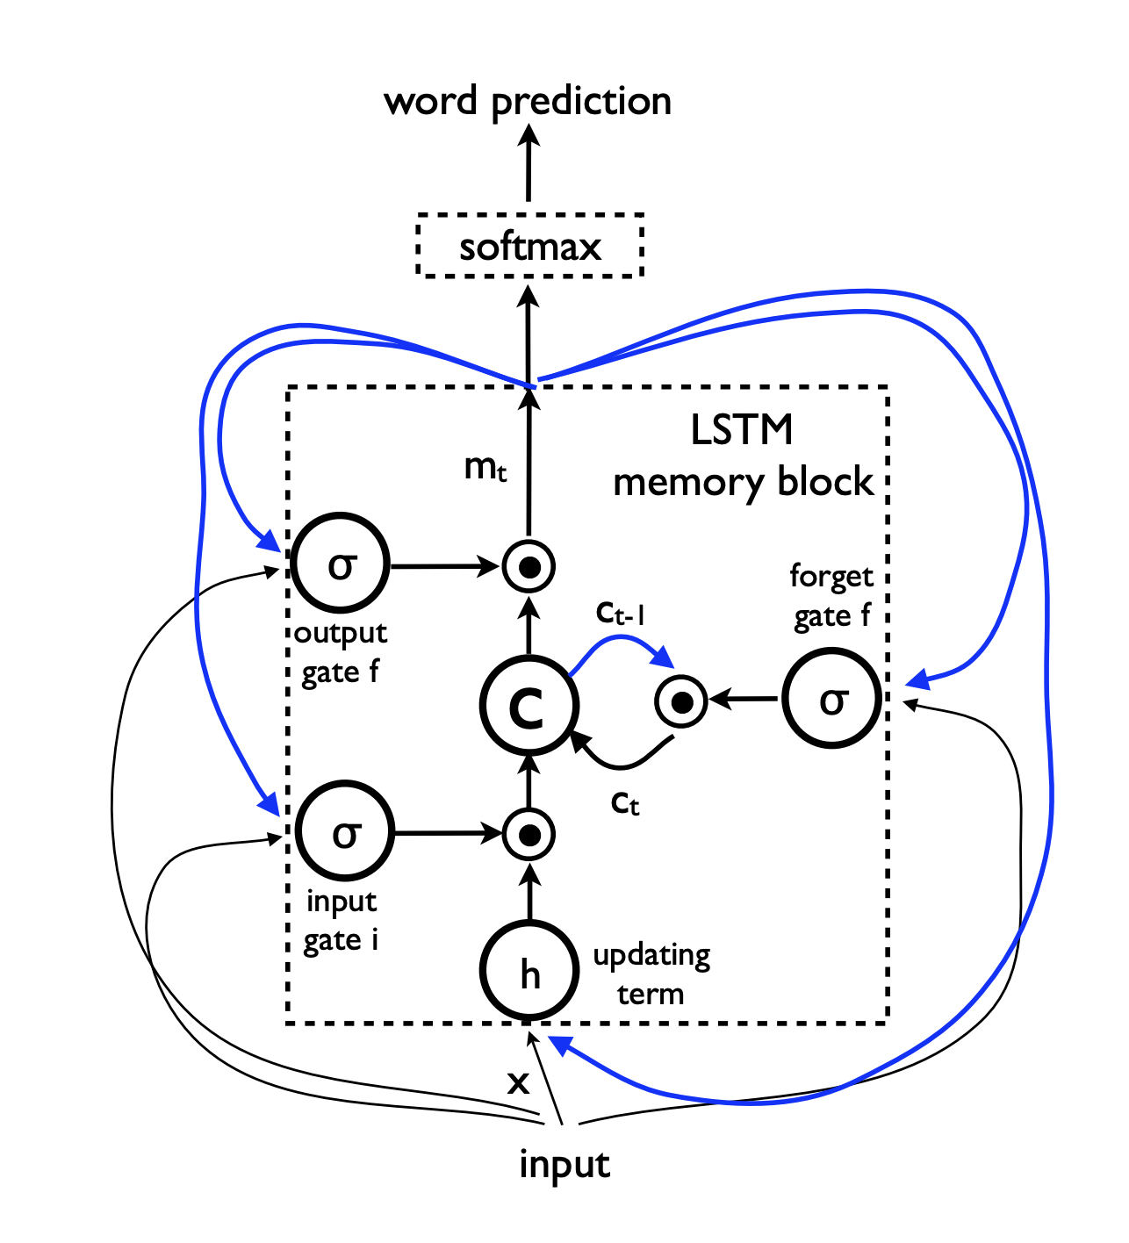
Background
Key Technologies
Uses Convolutional Neural Networks (CNNs) to understand image content.
Employs Recurrent Neural Networks (RNNs), particularly LSTMs, to generate descriptive text.
Ref: https://pradoposgrado2324.ugr.es/pluginfile.php/174122/mod_folder/content/0/4.3.ImageClassificationArchitectures.pdf
https://arxiv.org/abs/1411.4555
https://www.youtube.com/watch?v=YCzL96nL7j0&ab_channel=StatQuestwithJoshStarmer
Notes:
Structure: Unlike standard feedforward neural networks, LSTMs have a chain-like structure with repeating modules of neural network layers. The key to LSTMs is the cell state, which runs through the entire chain, with slight linear interactions. It’s very easy for information to just flow along it unchanged.
Gates: LSTMs use gates to control the flow of information. These gates can learn which data in a sequence is important to keep or throw away:
Input gate: Decides which values from the input to update the memory state.
Forget gate: Decides what information to discard from the block.
Output gate: Decides what to output based on input and the memory of the block.
Architecture: Consists of 16 convolutional layers and uses the ReLU activation function. This architecture is adept at capturing complex textures and patterns in images, which is beneficial for tasks requiring rich visual understanding.
Application: In your project, VGG16 is used to extract descriptive features from images. These features represent higher-level content in the images, such as objects, shapes, and scenes, which are crucial for generating relevant caption

Slide 4
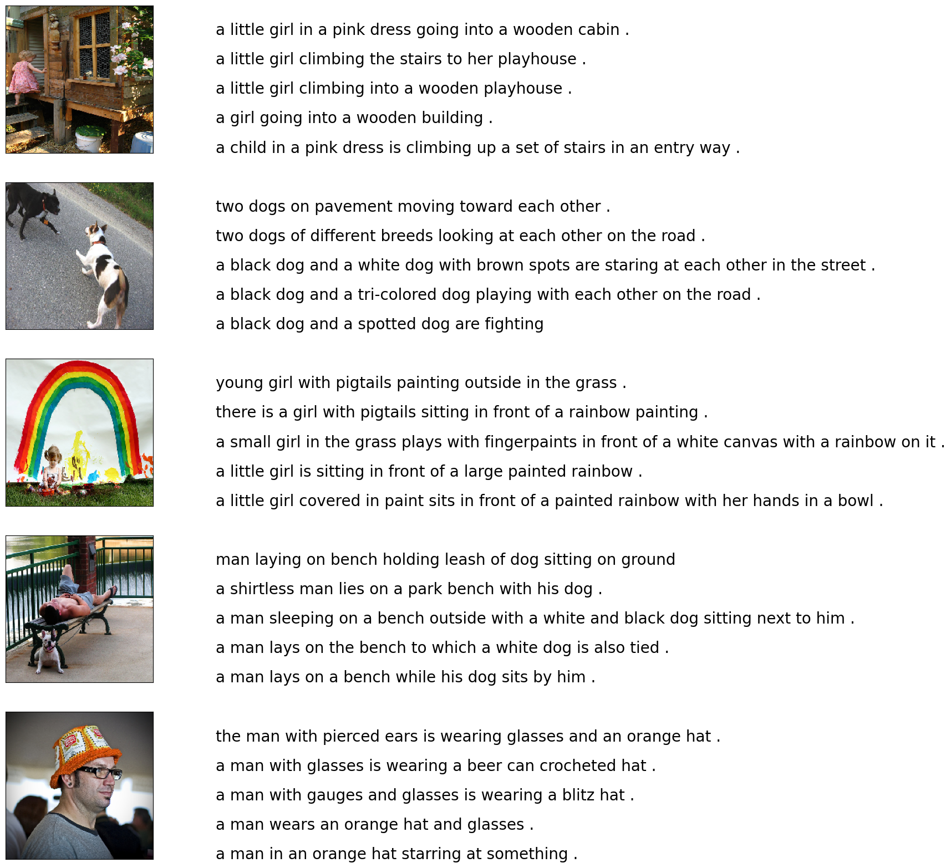
Step 1: Dataset
We used the Flickr8k dataset, containing 8,000 images each annotated with five different captions. This dataset is ideal for developing and testing image captioning models due to its diverse imagery and varied descriptions.
Each image in this dataset comes with multiple captions, providing rich linguistic diversity that helps in training robust models.
Ref: https://github.com/akshatchaturvedi28/Image-Caption-Generator-with-GUI

Slide 5
Step 2: Model Evaluation Matrix
We use the BLEU Score to evaluate the quality of text generated by our models. BLEU Score compares machine-generated captions to a set of reference captions and computes similarity scores.
This metric helps in quantitatively assessing the grammatical and semantic accuracy of the generated captions against the ground truth.
Ref: https://dl.acm.org/doi/pdf/10.3115/1073083.1073135
Notes:
N-grams: BLEU looks at the presence or absence of particular words and also at longer phrases, to judge the quality of the output. It counts matches of n-grams (sequences of n words) between the machine output and human translations and computes precision scores.
Smoothing: Given that the precision of longer n-grams will typically be lower, BLEU applies a brevity penalty to shorter translations, balancing against overly terse generation.

Slide 6
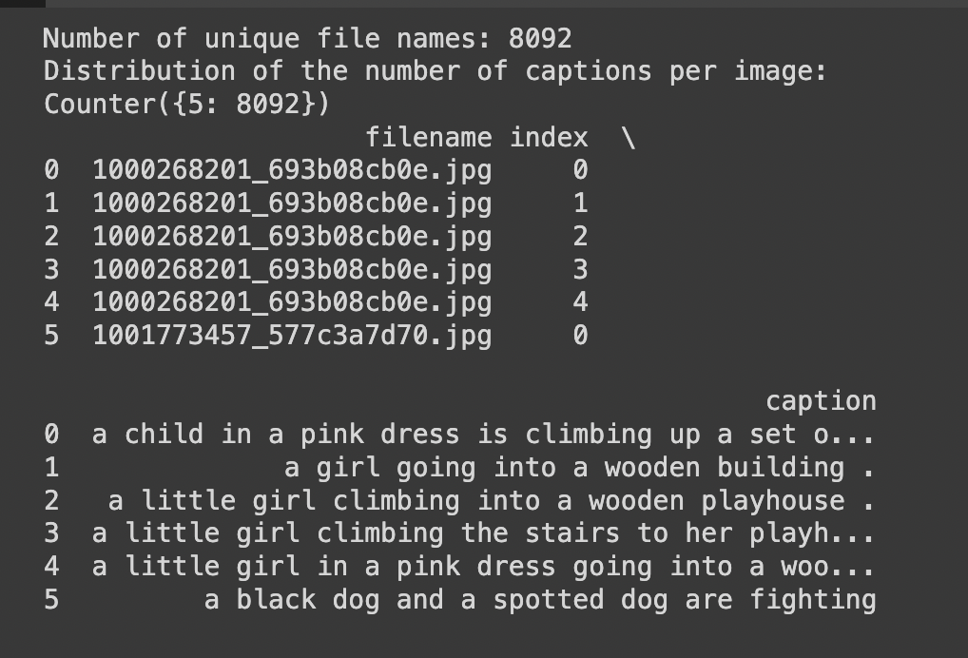
Step 3: Accessing the Data
Data was accessed and loaded through the Google Drive (downloaded and placed from Kaggle), ensuring a standardized and reproducible dataset version for consistency in our experiments.
Initial scripts prepare and segregate the data into training, validation, and test sets to ensure a comprehensive evaluation framework. (6:2:2 ratio)

Slide 7
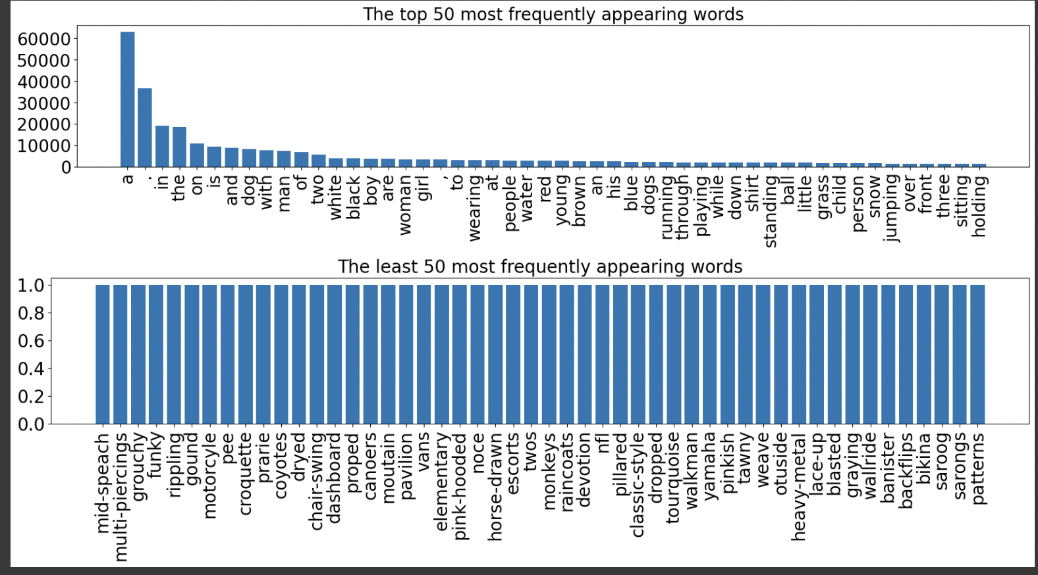
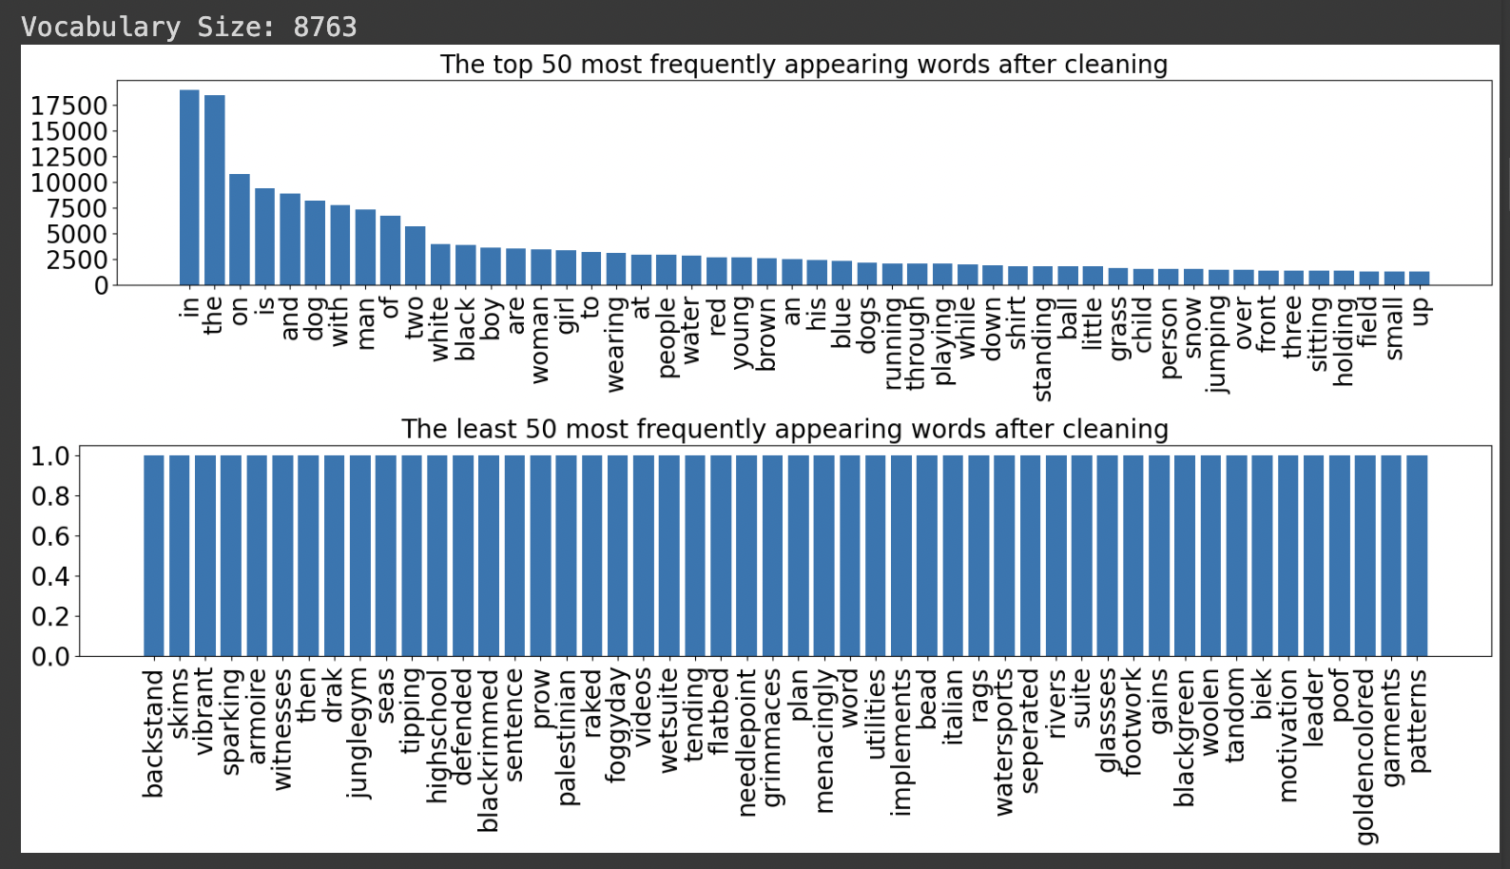
Step 4: Initial Analysis: Loading and Preparing Caption Data
Initial data loading involved parsing JSON files for captions and linking them with corresponding image identifiers.
Preprocessing steps included lowercasing, punctuation removal, and tokenization to standardize captions for processing.

Slide 8
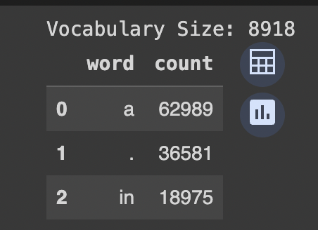
Step 5: Data Preparation: Building a Vocabulary
We constructed a vocabulary from the most frequently occurring words in our captions to reduce model complexity and improve learning efficiency.
Words occurring less than five times across all captions were excluded to focus on relevant terminology and reduce noise.
After cleaning, the Vocabulary Size: 8763

Slide 9
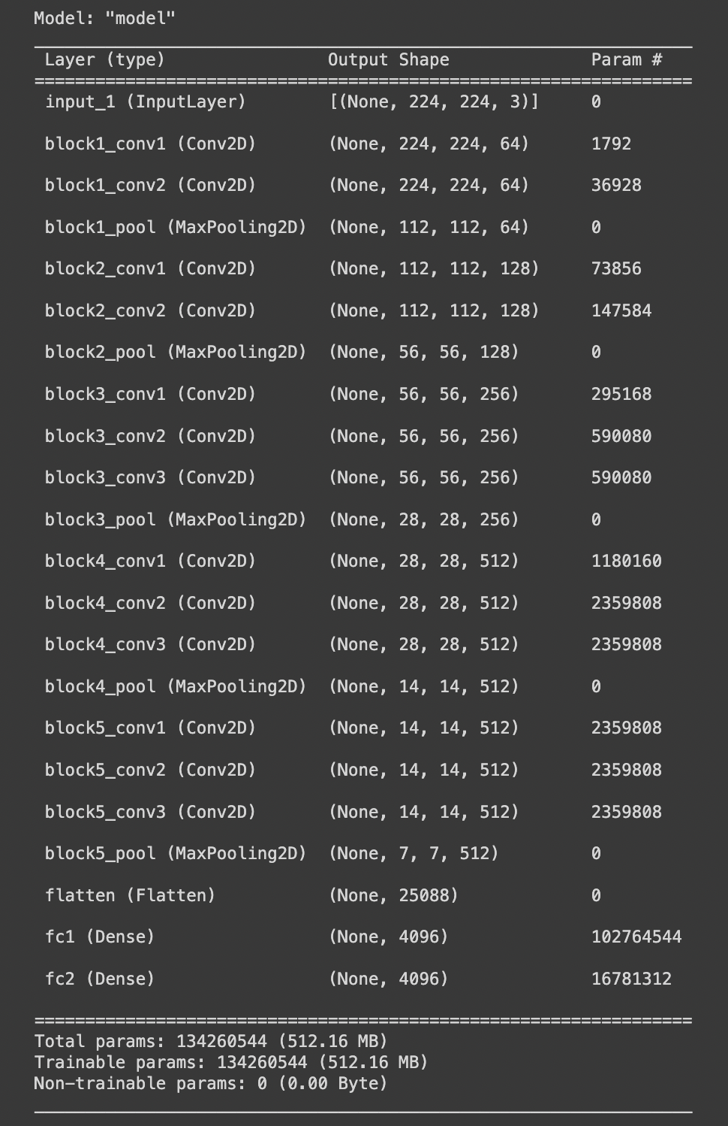
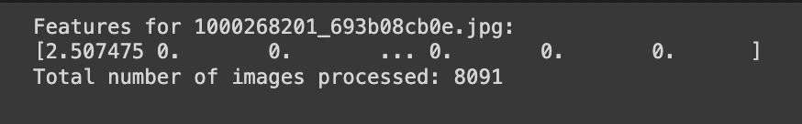
Step 6: Utilizing Pre-trained VGG16 for Feature Extraction
VGG16, pre-trained on ImageNet, was used to extract deep features from images, serving as the initial input to our LSTM model for generating captions.
This approach leverages transfer learning to boost initial accuracy without extensive training from scratch.
Ref: https://github.com/fchollet/deep-learning-models/releases/download/v0.1/vgg16_weights_tf_dim_ordering_tf_kernels.h5

Slide 10
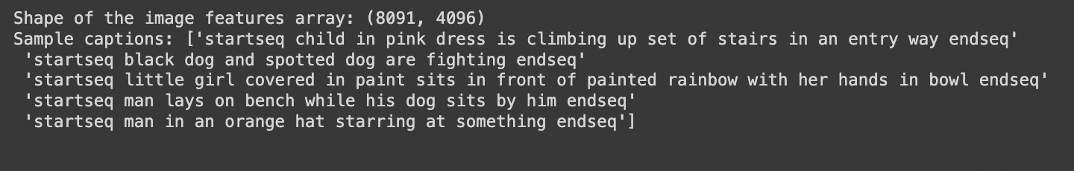
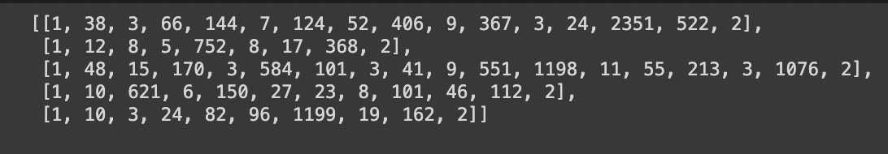
Step 7: Text Tokenization for Caption Processing
Captions were tokenized into words, and each word was assigned a unique integer, forming the basis for sequence modeling in the LSTM.
This step converts textual input into a format that can be efficiently processed by neural networks, facilitating learning.

Slide 11
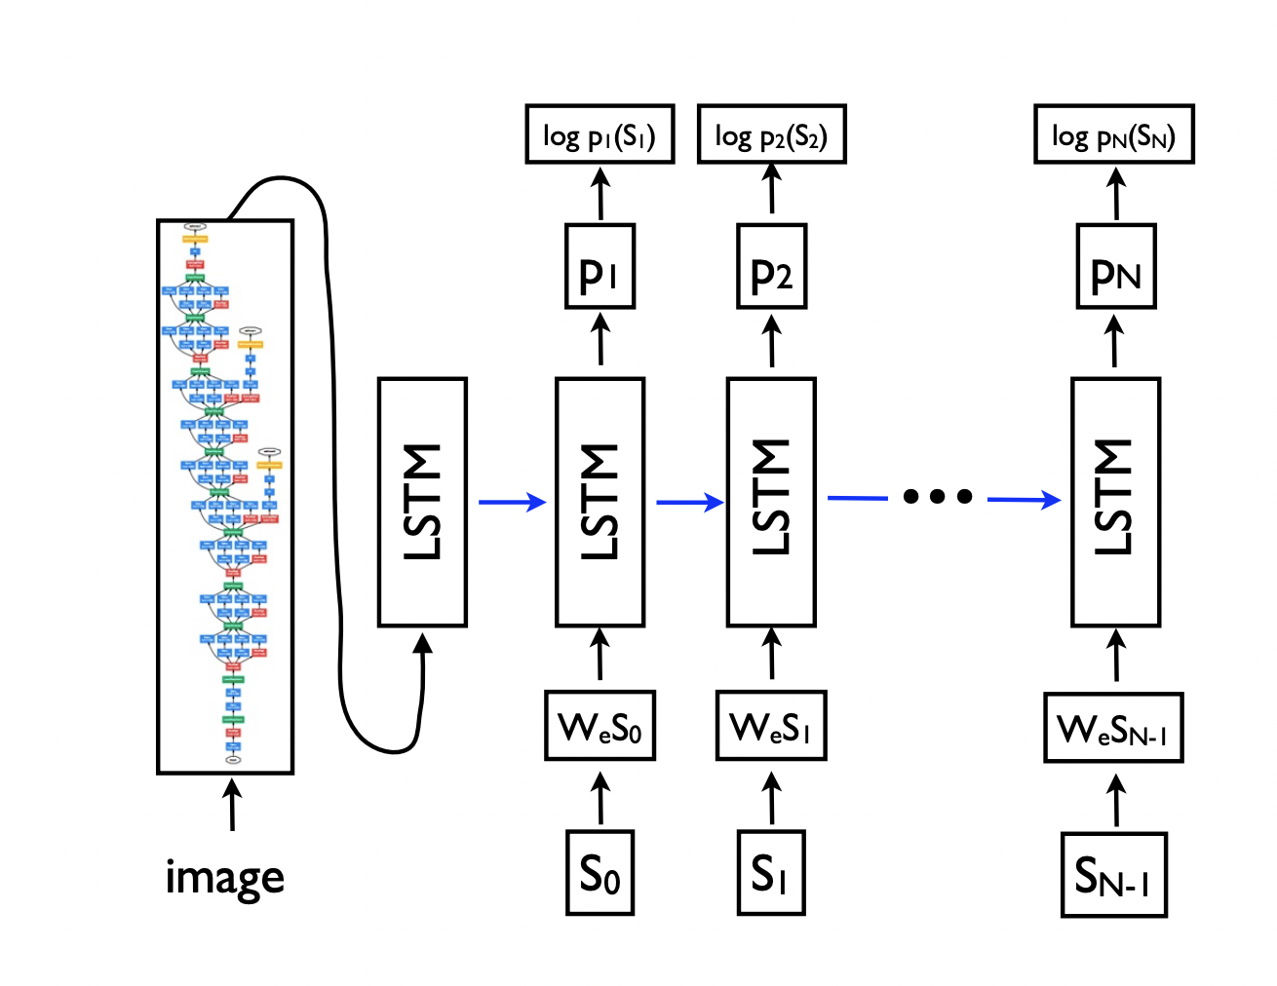
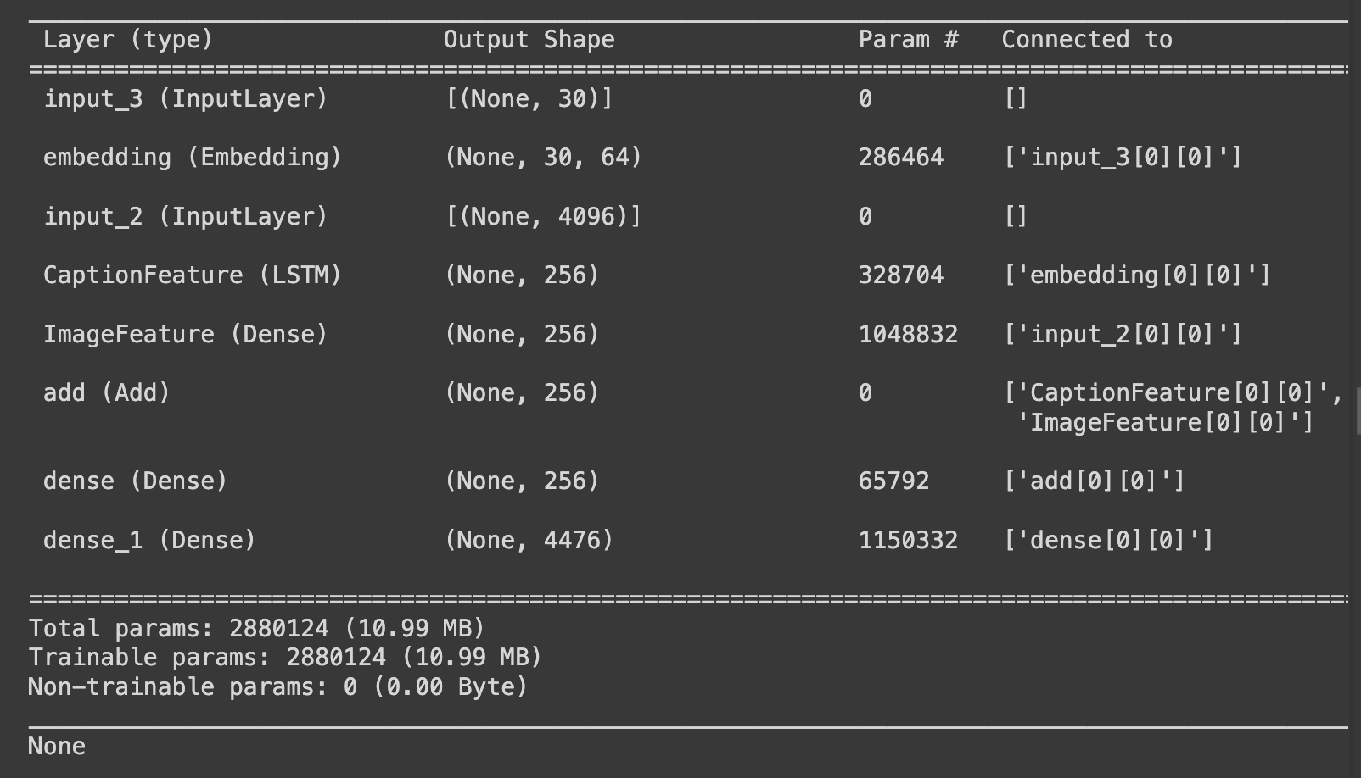
Step 8: Model Architecture for Caption Generation LSTM
Our caption generation model combines LSTM layers for text processing with dense layers that integrate image features from VGG16.
The architecture is designed to balance the influence of visual and textual inputs, generating coherent and contextually relevant captions.
Ref: https://arxiv.org/abs/1411.4555

Slide 12
Step 9: Evaluating Model Performance with BLEU Score
Post-training, the model’s performance was evaluated on a separate test set using BLEU Score, highlighting its effectiveness in real-world scenarios.
The BLEU scores provided insights into the linguistic quality of captions, informing further fine-tuning.

Slide 13
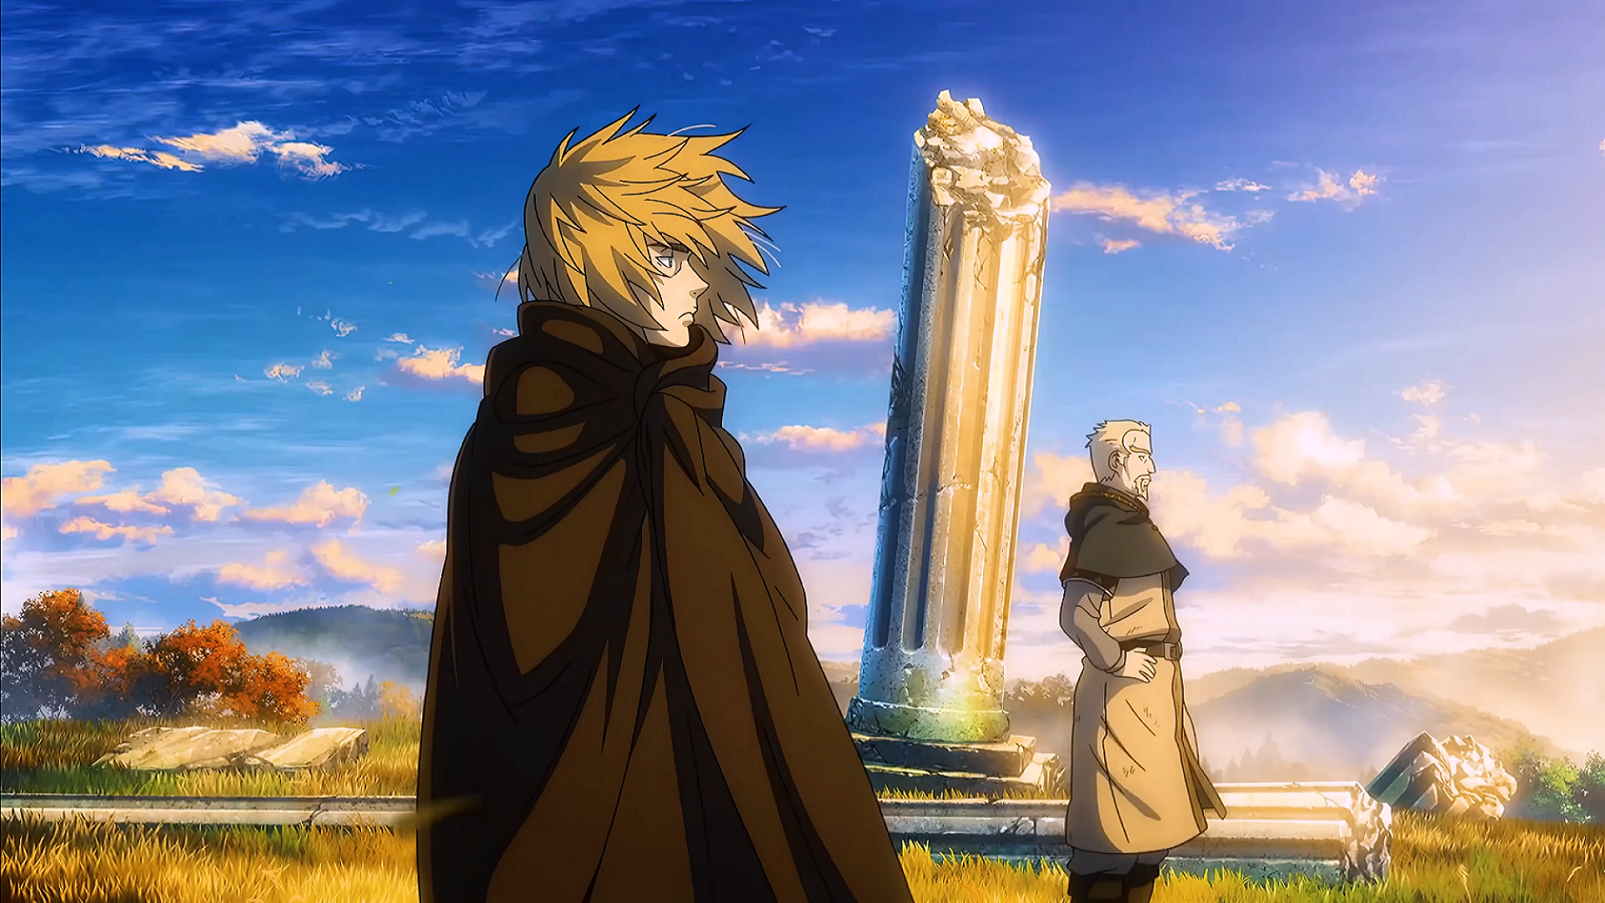
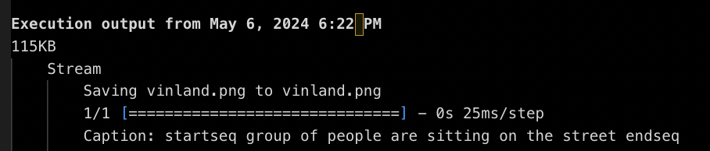
Step 10: Image Upload and Caption Generation
The system allows for uploading new images via a user interface, automatically generating captions based on learned models.
This functionality demonstrates the practical application of our model in real-time image understanding and caption generation.

Slide 14
Model Configuration and Parameters
Loss Function
Utilizes categorical crossentropy to measure the discrepancy between predicted and actual captions.
Activation Functions
ReLU for non-linearity in hidden layers.
Softmax in the output layer for normalizing the output to probability distribution.
Optimizer and Learning Rate
Adam optimizer for efficient learning rate adjustments.
Initial learning rate set at 0.001.
Batch Size and Epochs
Batch size: 64 — balances computation efficiency and model performance.
Epochs: 5 — sufficient for experimenting.

Slide 15
Experiments
Setup and Challenges
Configured TensorFlow to use Apple's Metal API, overcoming initial compatibility issues and optimizing for GPU performance.
https://developer.apple.com/metal/tensorflow-plugin/
Failed to re create Neural Talk (wasted a lot of time)
https://github.com/karpathy/neuraltalk2
Libs are too old (Torch)
Unable to install it on windows only supported in mac and linux
Tried docker: https://github.com/beeva-enriqueotero/docker-neuraltalk2
Tried to convert the torch model via: https://github.com/microsoft/MMdnn

Slide 16
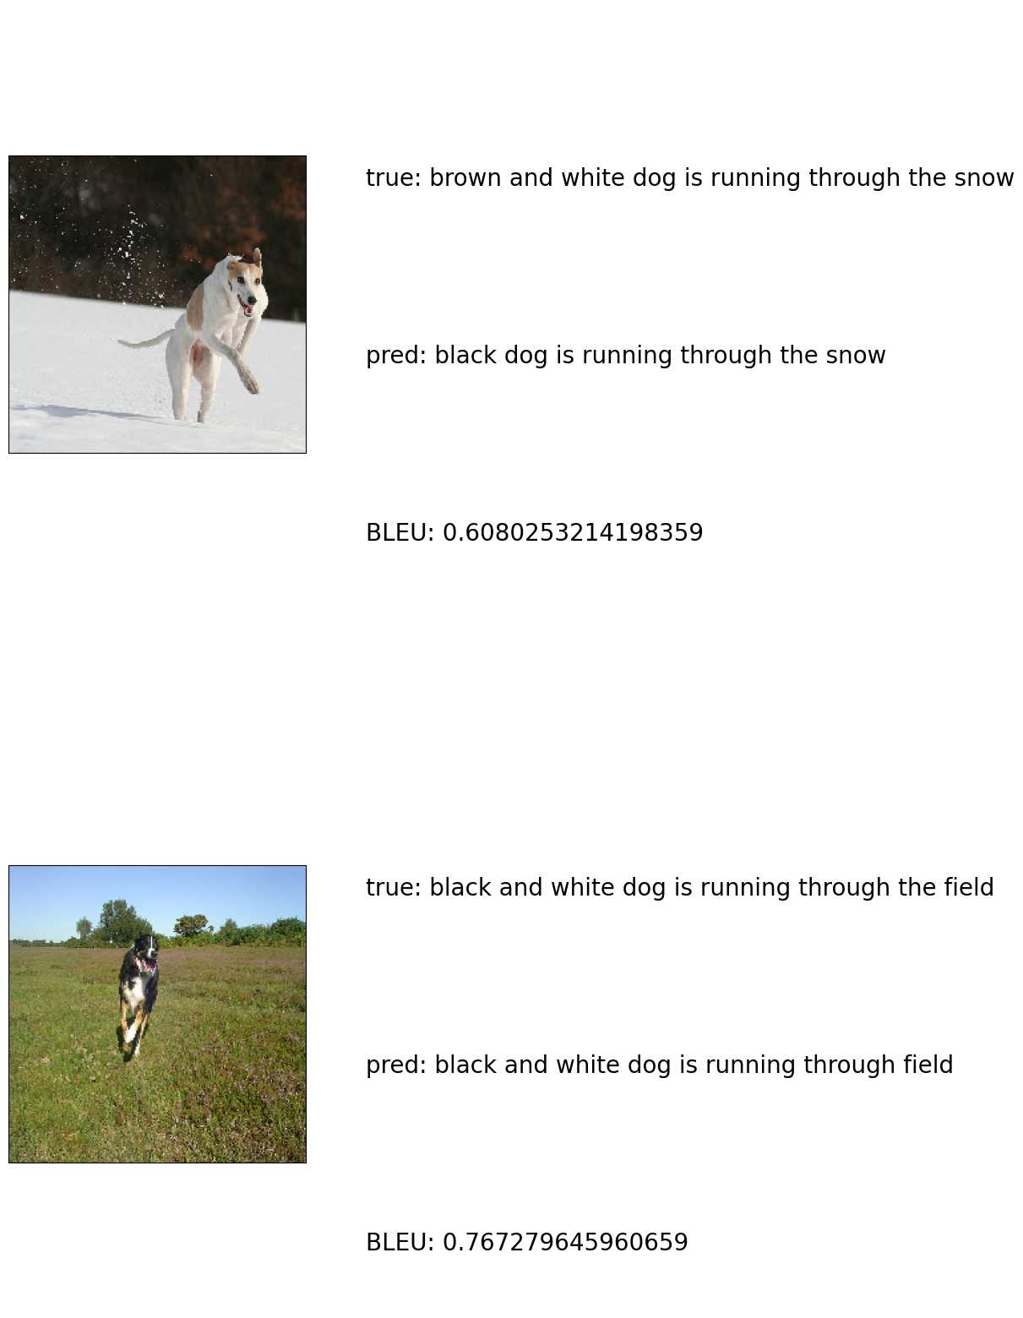
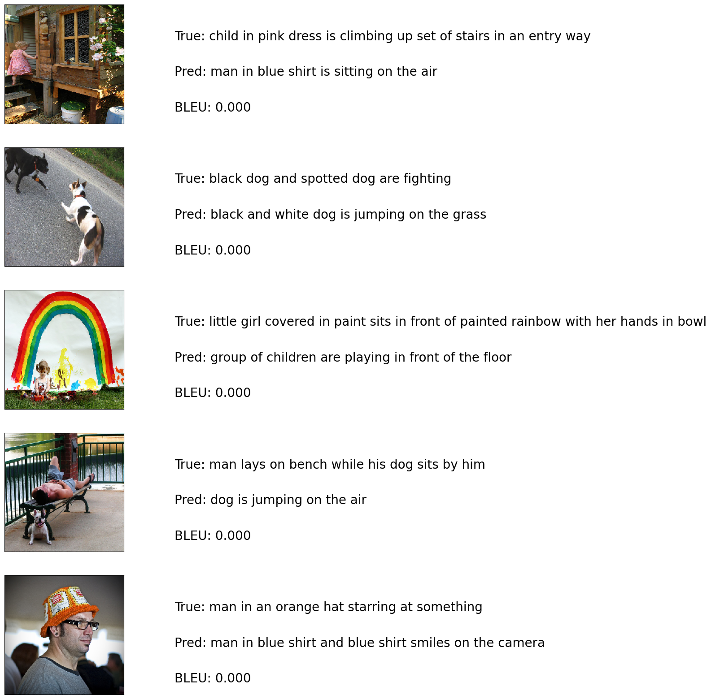
Results
Performance Overview
Displayed through graphs showing training versus validation loss over epochs.
Caption Samples
Showcases examples of successful and less accurate captions generated by the model.

Slide 17
Learning Outcomes
Data Preprocessing (Tokenization)
Using pretrained model
How to configure GPU on local and run your .ipynb file
LSTM and RNN
VGGNet Practical usage
TensorFlow
BLEU Metrics
MMdnn
Different papers regarding image captioning
Right direction for future exploration : Transformers
How to save models and evaluate later
Uploading an image to colab notebook
How to write a professional CV Report and Present

Slide 18
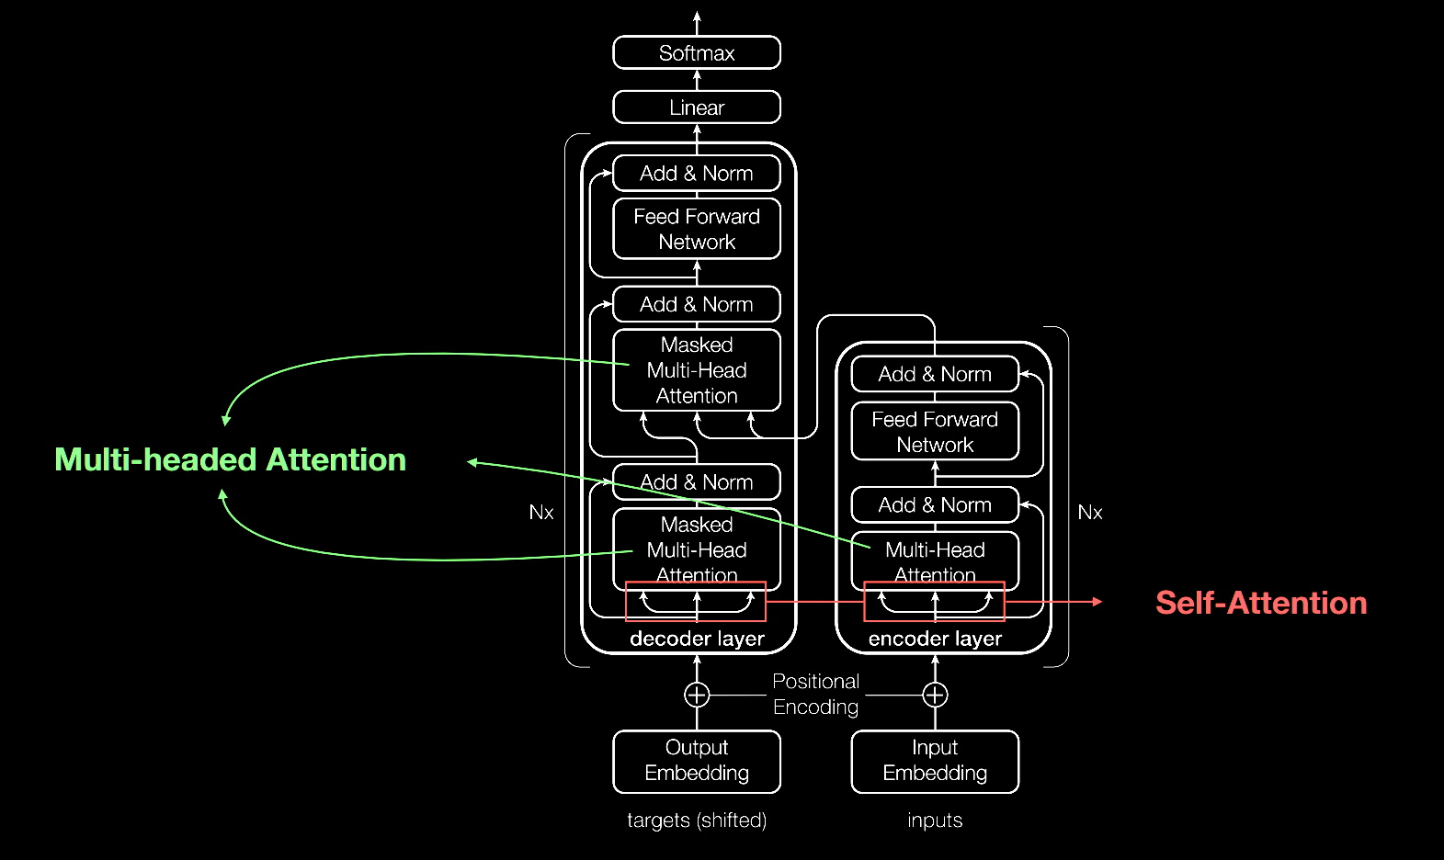
Conclusions and Future Work
Key Takeaways
The LSTM and VGG16 combination is effective but requires enhancements for complex scenarios.
Next Steps
Future work will explore using Transformers and expanding the training dataset to include more diverse images.
Ref: https://blogs.nvidia.com/blog/what-is-a-transformer-model/

Slide 19
Q&A
Thank you for your attention! We welcome any questions or suggestions! :))

